Slide 1
Insert subject here

Slide 2
What's happening
Character traits
pictures
Where am I
clips
100
100
100
100
100
200
200
200
200
200
300
300
300
300
300
400
400
400
400
400
500
500
500
500
500

Slide 3
What's happening?– 100
The crowd is cheering loudly
Men in helmets are running down a field
One man throws a brown ball
What's going on?
A football game is being played

Slide 4
What’s happening - 200
Someone asks “are we there yet?
The car is filled with suitcases.
Your parents missed the exit.
What’s happening?
Family road trip

Slide 5
What’s happening- 300
The doctor tells you to stay home
Your throat hurts
Your mom brings you soup to eat
What’s happening?
You have strep throat

Slide 6
What’s happening- 400
You put the leash on fluffy
Fluffy looks excited when you walk towards the door
You make sure and hold on tightly when you leave the house
Going to walk fluffy who is a rowdy dog

Slide 7
What’s happening- 500
Cheering is going on
Bright flashes went off in the air
Tons of people were wearing red, white, and blue
What’s happening?
Families were celebrating the fourth of July

Slide 8
Alexander 100
http://www.youtube.com/watch?feature=player_detailpage&v=3UU30-0J-Iw
What is a characteristic of alexander that you could draw from the video?
Friendly

Slide 9
Alexander - 200
What about alexander do you think the other students liked?
Answers may vary

Slide 10
Alexander - 300
How do you think alexander felt when his friends left? What mad you think this?
Lonely, sad, abandoned. His facial expressions.

Slide 11
Alexander - 400
How do you think alexander felt when his friends rejoined him? Why?
Excited, relieved, overjoyed. He had a smile on his face again

Slide 12
Alexander - 500
What do you think will happen to alexander next?
Answers will vary

Slide 13
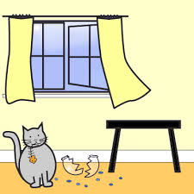
pictures– 100
The cat broke the bowl to eat the fish

Slide 14
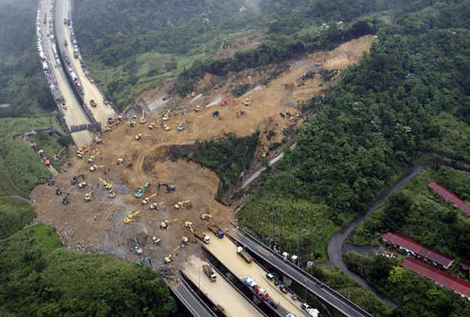
pictures- 200
A mud slide washed the road away

Slide 15
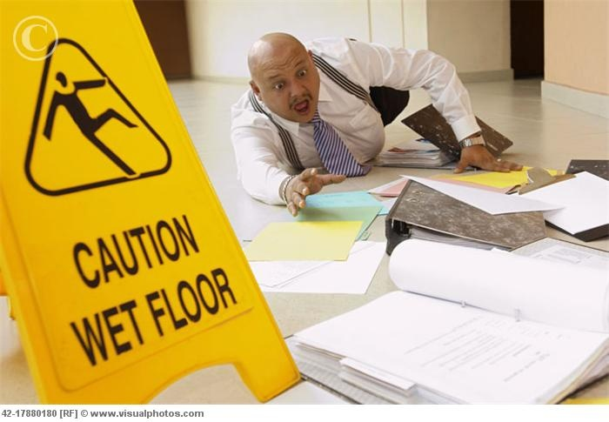
pictures- 300
The man slipped and dropped his papers

Slide 16
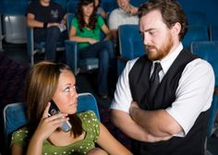
pictures- 400
The usher is telling the woman in the theater to get off her phone

Slide 17
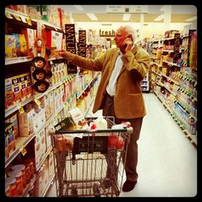
pictures - 500
The old man is calling his wife to see what he needs to get from the store

Slide 18
Where am I - 100
Sara noticed the name on the door as she walked closer to the office, Dr. Newton. Sara hoped he was smart because she didn’t want her teeth to hurt any more than they already do. She stepped in the office holding her moms hand. The doctor handed her a lollipop and walked her to the sitting area.
Where is Sara?
The dentist

Slide 19
Where am I - 200
Frank was all set, he had his pencils, notebooks, and new book bag. He walked through the doors and saw all of his old friends. He waved to the familiar faces as he walked down the new hall way.
Where is Frank?
First day of school

Slide 20
Where am I - 300
Tina walked through the gates with anxiety. She doesn’t like to go on curvy roads so she wasn’t sure how she would make it through tonight. She gathered her tickets at the ticket booth and met her friends in line.
Where is Tina?
Amusement park

Slide 21
Where am I - 400
Morgan walked through the store with her list in her hand. She decided to leave the kids at home so she could get done quicker. She raced through the store getting what she needed for that weeks supper. She got in line and found out she forgot her cash at home.
Where was Morgan?
The grocery story

Slide 22
Where am I- 500
Mary had to make sure she put her helmet on before she stepped outside. She looked around and saw the beautiful stars and universe in her surroundings. She stepped outside and felt like she was flying. Mary ran to the crater and hid from her friend Max. They played tag the rest of the afternoon.
Where is Mary?
Outerspace

Slide 23
clips - 100
http://www.youtube.com/watch?feature=player_detailpage&v=i_Psl0nFEzw
The crabs are smart and realized that they can defeat the bird if they work together

Slide 24
clips- 200
https://www.youtube.com/watch?feature=player_embedded&v=ylZgK42Lovw
They are both very determined

Slide 25
clips - 300
http://www.youtube.com/watch?feature=player_detailpage&v=l3keGElnSh4
the bear has never seen the machine before
He doesnt know how to work a treadmill

Slide 26
clips - 400
https://www.youtube.com/watch?v=6Gv57Fs2qS8&feature=player_embedded
Nemo is afraid because he is in a new place

Slide 27
clips - 500
http://www.youtube.com/watch?v=QNsibN4D36A&feature=player_detailpage
They are competitive because they want to see who reaches the furthest

